Slide 1

THE SCRUM-AGILE APPROACH
BY TASHI ANDERSON

Slide 2
The various rolls on a scrum-agile team:
Product Owner
Scrum Master
Developers and Testers

Slide 3
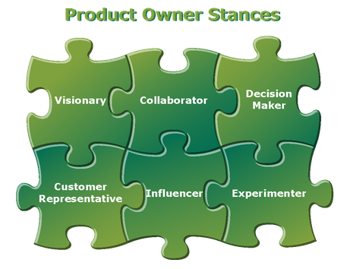
Product owners…
Are accountable for effective Product Backlog management
Delegate tasks to the scrum team
Remain responsible for the accomplishment and value of the product delivered.
https://www.scrum.org/resources/what-is-a-product-owner

Slide 4
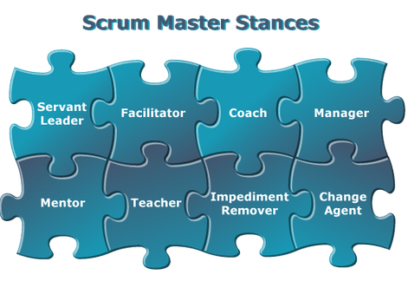
Scrum masters…
Facilitate Scrum to the larger team
Facilitate standups, retrospectives, sprint planning, etc.
Are adept at problem-solving
Coach the team on agile and Scrum principles.
https://www.scrum.org/resources/what-is-a-scrum-master

Slide 5
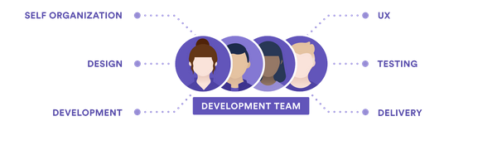
Developers and testers…
Have both developers and testers work hand in hand
Solve problems with code
Test user stories to understand feature requirements
Provide information to consumers on a product’s reliability
https://www.atlassian.com/agile/scrum/roles

Slide 6
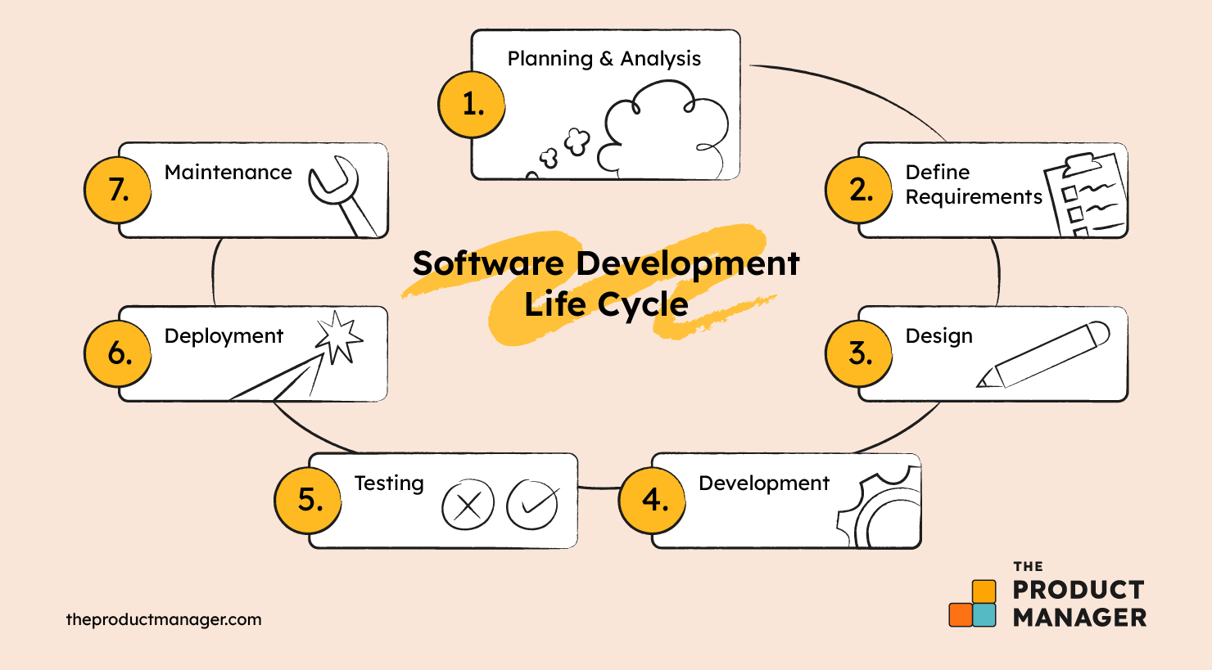
The various cycles of sdlc
Project planning
Gather business requirements from the client
Analysis
Clarify the requirements of the project
Design
Create flowcharts and develop a prototype of the product
Implementation
Development begins, set a timeline and milestones to set expectations
Testing
Often is merged with the implementation stage, can be automated or done in a contained environment
Deployment
Final product is delivered to the client, often is a scheduled deployment
Maintenance
Routine checks for bugs and potential upgrades
https://theproductmanager.com/topics/software-development-life-cycle/

Slide 7
Why not the waterfall approach?
WATERFALL SHORTCOMINGS
Waterfall has all parameters defined and planned for, unlike agile
The rigid structure does not allow for any sudden requirement changes
Agile proved to be the better choice for the SNHU Travel project. Agile is less rigid than waterfall, allowing for the client to change their requirements with more ease, and would have constant updates on the project because of the agile sprints.
If, for example, this was a smaller scale project, the waterfall approach might be more beneficial than the agile approach. The waterfall approach would allow for a smaller timeline, with less possible risks when faced with a requirement change.

Slide 8
references
Atlassian. (n.d.). A deep dive into scrum team roles. https://www.atlassian.com/agile/scrum/roles
Cobb, C. G. (2015). The Project Manager’s Guide to Mastering Agile: Principles and practices for an adaptive approach. Wiley.
The Product Manager, & Clark, H. (2024, April 17). The Software Development Life Cycle (SDLC): 7 phases and 5 Models. The Product Manager. https://theproductmanager.com/topics/software-development-life-cycle/
Product tester jobs: What are they and how can I get one?. Coursera. (n.d.). https://www.coursera.org/articles/product-tester-jobs
What is a product owner?. Scrum.org. (n.d.-a). https://www.scrum.org/resources/what-is-a-product-owner
What is a scrum master?. Scrum.org. (n.d.-b). https://www.scrum.org/resources/what-is-a-scrum-master

